Slide 1


Review
How to Fill out
An R2T4 Form
Carri L. Van Buskirk
Cash Management Officer
GEMCOR, INC.

Slide 2
Step 1
Bring Student up in TEAM Software
From the information in TEAM you will be able to fill in most of the information on your R2T4.
You will need the student’s full name
Social Security Number
What was disbursed to the student (PELL, SEOG, UNSUB, SUB, PLUS)
If those disbursements were disbursed before or after their Last Day of Attendance.
The student’s start date
The student’s Last Day of Attendance (LDA)
Which payment period the student dropped in.
R2T4 Clock Hour program

Slide 3
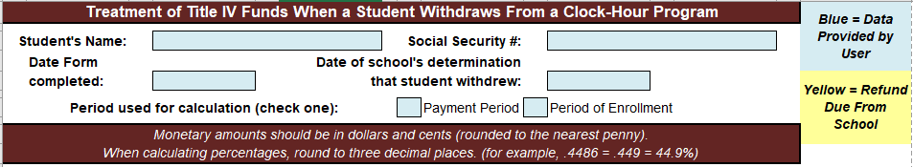
Step 2
What Do I Do Now with this Information??
This will all need to be entered into the different Steps on the R2T4
Below is the top portion to be filled in first.
  Student full name
  Social Security Number
  The date you completed the form
  The date you as a school along with the student, if possible, determine that they are a withdrawal.
  Please check Payment Period or Period of Enrollment
R2T4 Clock Hour Program

Slide 4
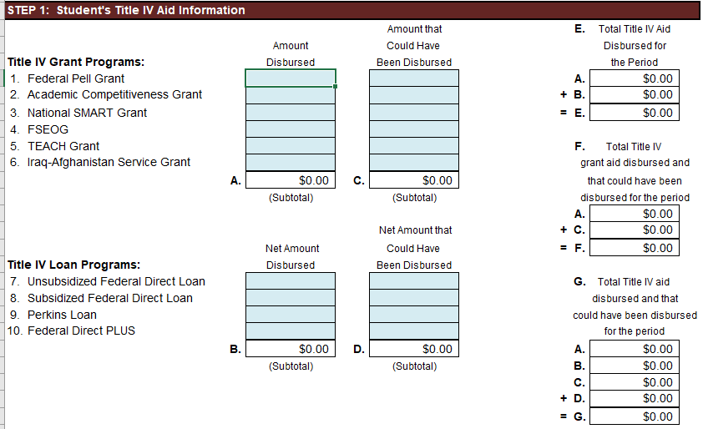
Step 3
Filling out Step 1 of the R2T4
  From TEAM find out if the student was disbursed funds for PELL and Loans
  If they were disbursed BEFORE their LDA enter them on the Disbursed column
  If they were disbursed AFTER their LDA enter them on the Could have been Disbursed Column
R2T4 Clock Hour Program

Slide 5
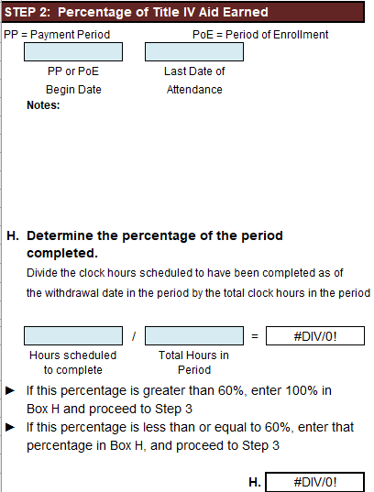
Step 4
Filling out Step 2 of the R2T4
From TEAM you will be able to find out the student’s start date for the payment period the student dropped in.
  For a 2nd or 3rd PP it will be the date the student hit that payment period.
You as the school will know the student Last Day of attendance.
  This will be the very last day the student was physically at the school or last day doing Distance Education.
R2T4 Clock Hour Program

Slide 6
Step 4 cont.
Filling out Step 2 Line H of the R2T4
For this step you will need the student’s scheduled clock hours for the payment period that they dropped in.
Then you will need to know the total clock hours in the payment period that they dropped in (i.e., 450 PP)
Once these 2 numbers are entered the R2T4 form will tell you the percentage the student earned. If it is under 60% you will move on to Step 5, if it is not then you will STOP, and the student has earned 100% of the Aid.
R2T4 Clock Hour Program

Slide 7
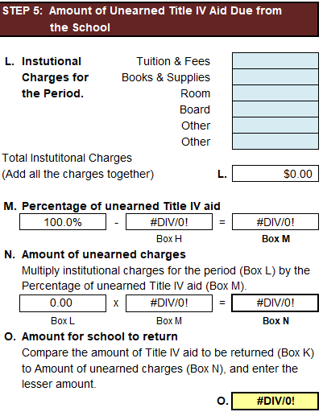
Step 5
Filling out Step 5 of the R2T4
Line L - Institutional Charges for the Payment Period
For this step you have to know the full Institutional charges for the student that dropped.
The charges you can include for just an R2T4 are
  Tuition
  Fees
  Books & Supplies
Once you have these number you then will use this in a formula call a proration
  i.e., $15,000 (total tuition and fees and supplies to go school) / divided by 1500 clock hours for the program the student is in * multiplied by 450 clock hours in the payment period the student dropped in = $4500 prorated Institutional charges for the payment period the student dropped in.
  This is the amount you would enter in the top box for tuition and supplies for step 5 line L.
$15,000 / 1500 * 450 = $4,500
R2T4 Clock Hour Program

Slide 8
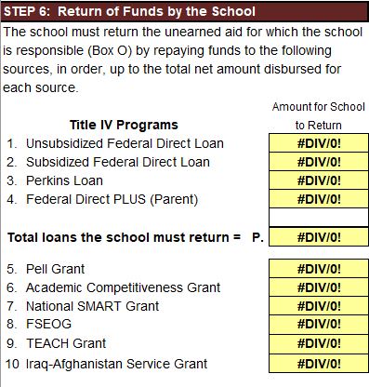
Step 6
Once all the Blue boxes have been filled in with all the student’s information on the R2T4, step 6 will then calculate automatically the amount of unearned funds that the school will be responsible for to refund back to the Department of Education.
Then you can enter that into TEAM for processing and then deposit the funds into your Federal Funds account.
This then completes the R2T4 process
R2T4 Clock Hour Program

Slide 9
Questions or Comments
Carri Van Buskirk
Cash Management Officer
GEMCOR, Inc.
1-888-GEMCOR-8
Carri@gemcorinc.com
R2T4 Clock Hour Program

